Slide 1
Employment payment management system
16551A0538

Slide 2
Introduction:
“EMPLOYEE PAYMENT MANAGEMENT SYSTEM” project is a project implemented it for Employee weekly salary payment with overtime bonus calculate application. and also generate employee payment slip and also include tax.it is very useful to run the business and easily calculate the salaries.
The project “Employee payment Management System” is implemented to reduce the manual work of hour department and give the employee the full details of his working hours.
EMPLOYEE PAYMENT MANAGEMENT SYSTEM project is developed in python language which is developed using Tkinter,python3.6 and Database no database. This is a simple and basic small level project .

Slide 3
Python features:
Easy-to-learn − Python has few keywords, simple structure, and a clearly defined syntax. This allows the student to pick up the language quickly.
Easy-to-read − Python code is more clearly defined and visible to the eyes.
Easy-to-maintain − Python's source code is fairly easy-to-maintain.

Slide 4
Python graphical user interfaces (GUIs)
Tkinter − Tkinter is the Python interface to the Tk GUI toolkit shipped with Python. We would look this option in this chapter.
Database-a data base is used to store data in an organizing manner whike making retrivel and updating of data efficient.

Slide 5
PYTHON TKINTER GUI :
Creating a GUI application using Tkinter is an easy task. All you need to do is perform the following steps −
Import the Tkinter module.
Create the GUI application main window.
Add one or more of the above-mentioned widgets to the GUI application.
Enter the main event loop to take action against each event triggered by the user.

Slide 6
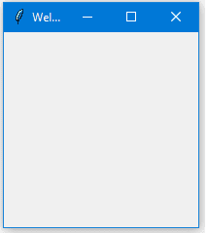
Example of tkinter
#!/usr/bin/python
import tkinter*
Window=tk()
Window.title(“welcome to python tkinter”)
Window.loop()

Slide 7
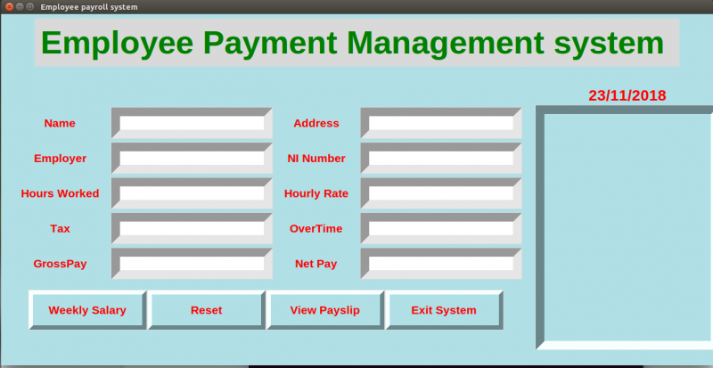
Employee payment management system
GUI – Main display window with name of employee payment management system name current time and date with view pay slip

Slide 8
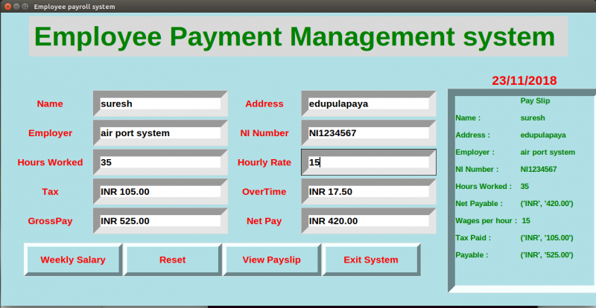
We can enter the details like this and receive pay slip like this:

Slide 9
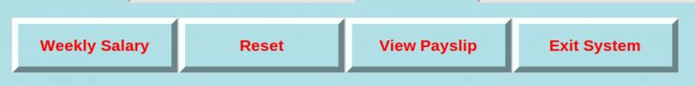
Buttons used :
Weekly salary
Reset
View pay slip
Exit system

Slide 10
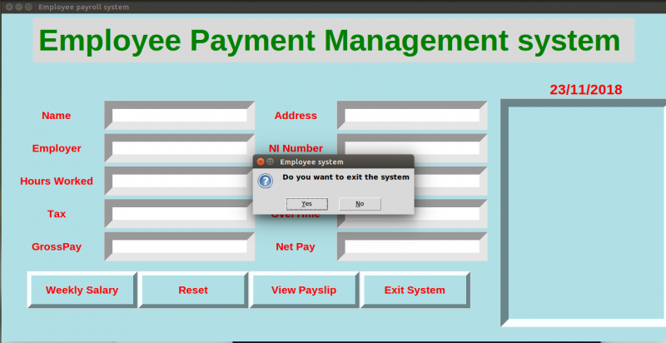
In case of you wish to exit system:

Slide 11
Conclusion :
This is a basic project of python which helps HR department to reduce their time on spending different data of an employer and how many hours the employer worked with bonus tax for his extra work .
It makes the employer understand how many days he worked and how many hours and hourly how much salary they will be getting for an hour in a pay slip.

Slide 12
Thank you
16551A0538
K.MUKTA.

